Slide 1
National Master Data as 5 Star Linked Open Data
Results from the SEMICOLON II project
Per Myrseth, DNVKEMA, Intelligent Networks & Communication
IFIP EGOV 2012, 3-5 September

Slide 2
Agenda
Introduction
Context
Motivation
Terms
Research question
The Linked Open Data pilots
Measuring the results
Discussion and conclusion

Slide 3
Introduction
Semicolon project
Period : 2007 – 2013,
Budget ~15 million dollar, including value of work hours from public partners
Goal: Seek cost effective and improved methods and tools for establishing eGov solutions.
Semicolon project are partially funded by the Research Council of Norway
Important activity: Open Data
Make demonstrators based on semantic technologies and open public data
Case: Open up public registers
Central Coordinating Register for Legal Entities/Companies
Register of Company Accounts. Yearly economic status
National metadata repository, The semantic register of electronic services (SERES)

Slide 4
Data Context: Core National Master Data
Persons/Citizens
Maintained by
The Brønnøysund Register Center
Companies/
Legal entities
Economic
data
Properties, addresses
and maps
Metadata

Slide 5
Motivation related to usage patterns
Meet the new usage trends
Increasing usage of the data
New ways of using data within traditional usage areas
New usage areas and patterns
Increasing request for merging data

Slide 6
Some Terms
Public sector data
Linked data
*****
Linked open
public data
Enterprise data
Open data
Personal data
Crowd made data/ Wikipedia
….

Slide 7
Research question
How can Linked Open Data improve interoperability?
Technical and
semantic
interoperability
as two
important
levels of
interoperability
Interoperability
research
and electronic
government
research
points to
Linked Open
Data influence
technical
and semantic
interoperability
Make some
pilots and
measure results

Slide 8
5-star deployment scheme for Linked Open Data
★ | Available on the web (whatever format) but with an open licence, to be Open Data
★★ | Available as machine-readable structured data (e.g. excel instead of image scan of a table)
★★★ | As (2) plus non-proprietary format (e.g. CSV instead of excel)
★★★★ | All the above plus, Use open standards from W3C (RDF and SPARQL) to identify things, so that people can point at your stuff
★★★★★ | All the above, plus: Link your data to other people’s data to provide context

Slide 9
The pilots
RLE data in a time line perspective (★★★) (Finished 2009)
RLE data subset (★★★★) (2010)
SERES RDF, Norwegian Semantic Repository of Electronic Services (★★★★) (2011)
RLE data linked to SERES metadata (★★★★★) (2011)
RLE and financial data with metadata (★★★★★) (2011)
RLE = Register for legal entities/Companies

Slide 10
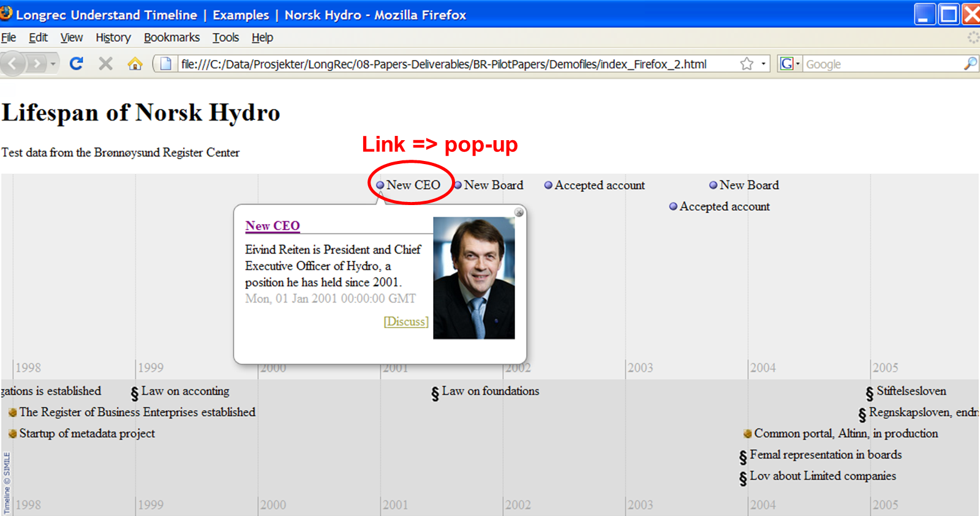
1. RLE data in a time line perspective [16] (★★★)

Slide 11
2 RLE data subset (★★★★)
Excel macro
Get address
National
master data
Org.nr | Name | Address
945 748 931
974 760 673
BRREG.NO RLE
Enterprise
data
BRREG.NO
Web and application- server
Web Services
Org.nr | Name | Address
945 748 931 | Det Norske Veritas | Veritasveien 1
974 760 673 | Registerenheten i Brønnøysund | Havnegate 48
Notes:
Tjeneste trappa, mulig nivå 4, men slitsomt og dyrt

Slide 12
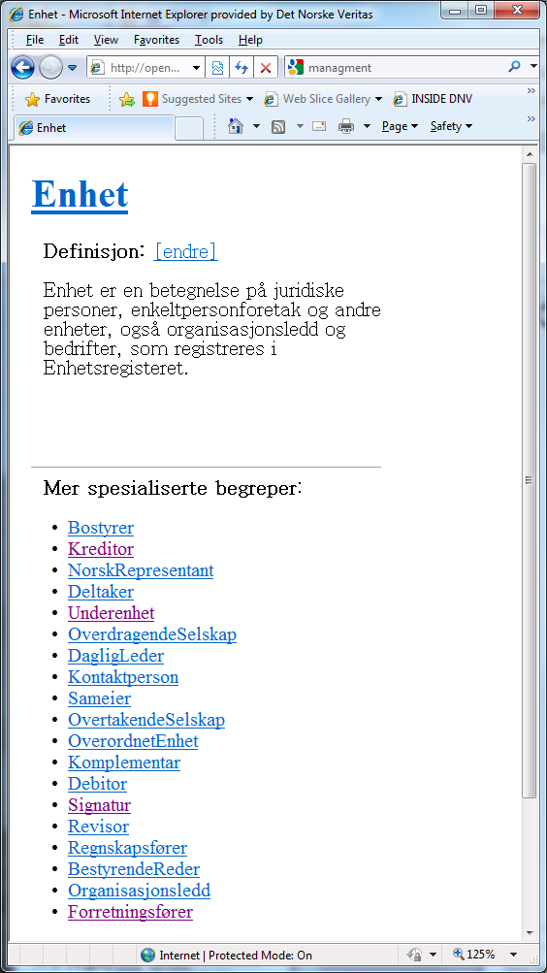
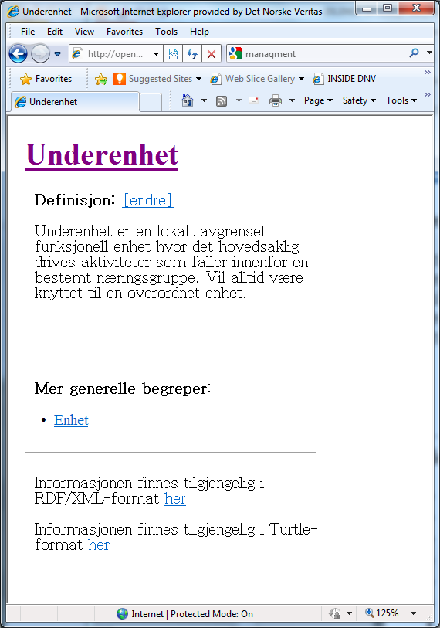
3. SERES RDF, Norwegian Semantic Repository of Electronic Services (★★★★)

Slide 13
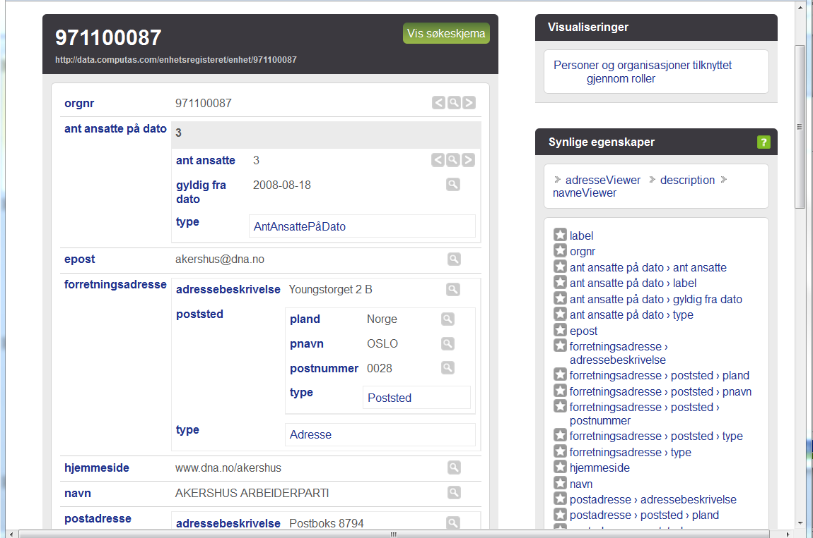
4 RLE data linked to SERES metadata (★★★★★)
Example data from the Labor party in Akershus municipality

Slide 14
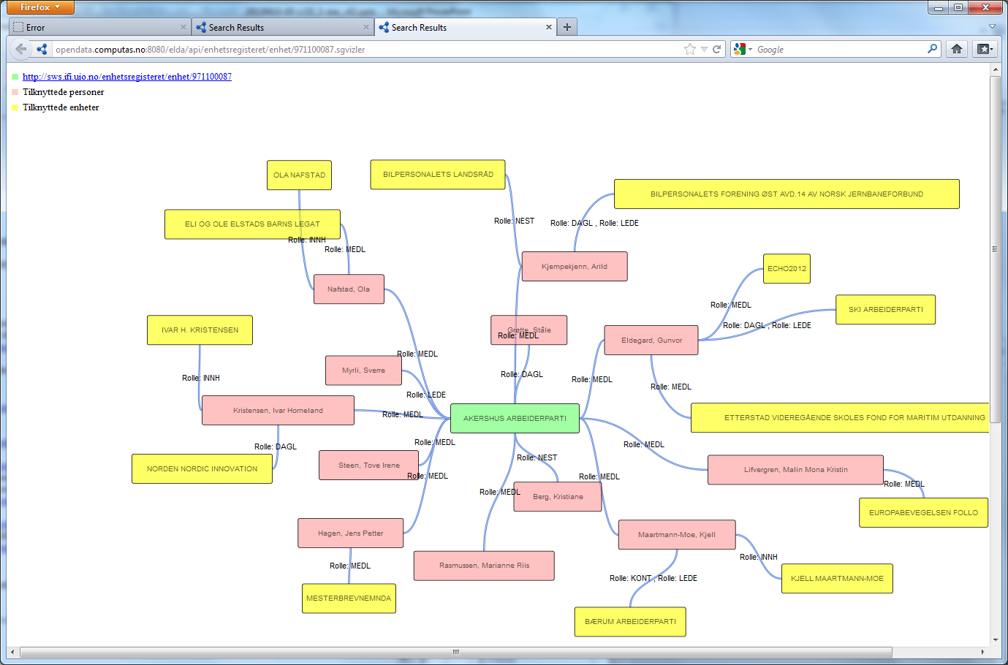
4 RLE data linked to SERES metadata (★★★★★)
Akershus Labor Party

Slide 15
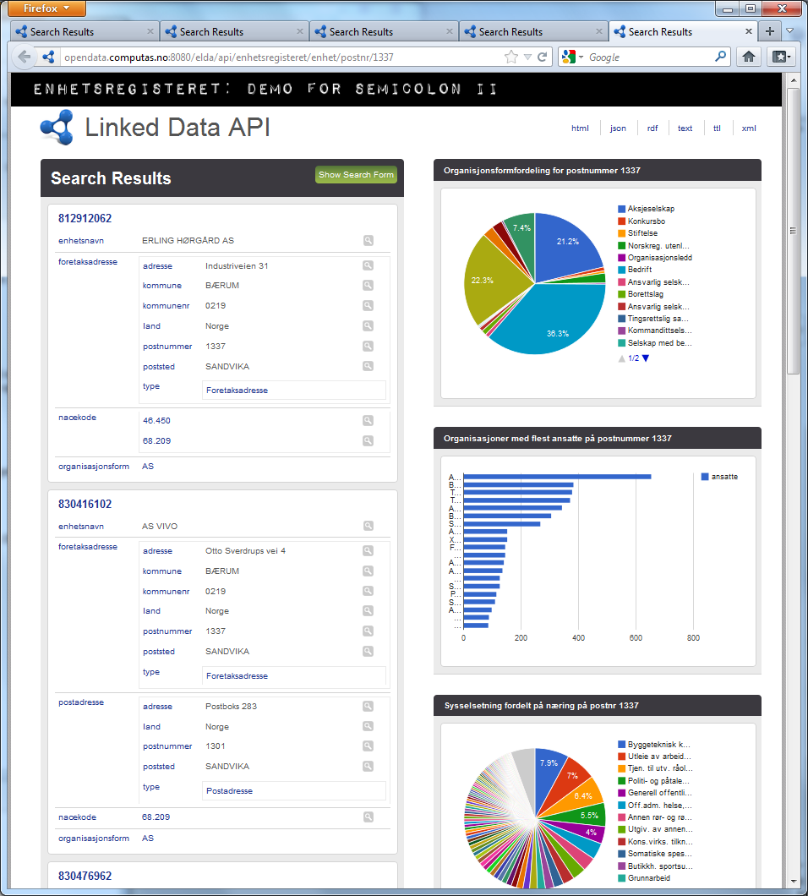
Search criteria:
Post number
= 1337
SANDVIKA

Slide 16
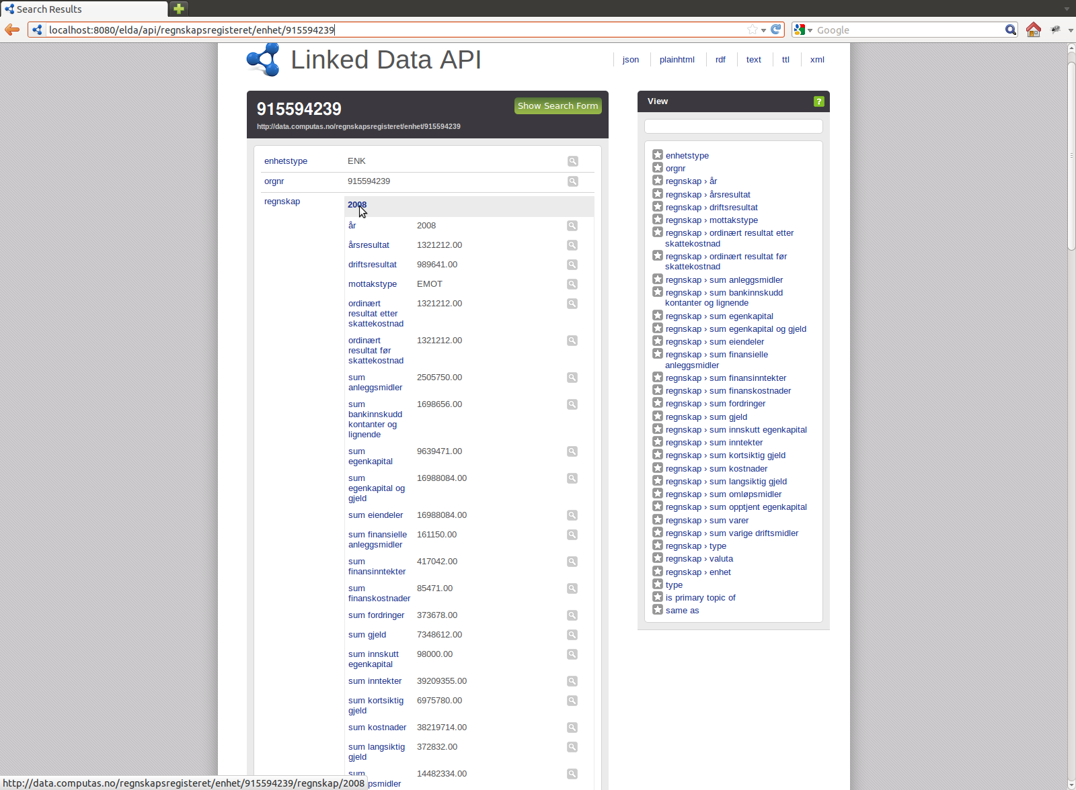
RLE and financial data with metadata (★★★★★)

Slide 17
Research question, repeated
How can Linked Open Data improve interoperability?
Technical and
semantic
interoperability
as two
important
levels of
interoperability
Interoperability
research
and electronic
government
research
points to:
Linked Open
Data influence
technical
and semantic
interoperability
Make some
pilots and
measure results

Slide 18
Measuring the pilots
Cost reduction in establishing IT-solutions dependent on several external information sources.
Score: Medium.
No comparable financial figures exist to conclude if semantic technology actually reduces costs in establishing IT-solutions. But the experience from making the pilots is valuable proof of concepts which can be used to argue for improvements.
Effort needed in order to understand external data, build trust in them, and risk management of external data.
Score: Good
The lack of provenance data and data quality indicators is challenging both from a semantic, a trust and a risk perspective. The score is set to be good even if a relevant business risk assessment has not been performed.
Ability for IT systems to change.
Score: Do not have observations to conclude on this indicator
Re-use of data.
Score: Good

Slide 19
Discussion, Seeing is believing
New usages pop up when the costs of data drop to zero.
Important drivers for increased use of data are
reduced effort to make usage technically possible
reduced effort to understand data
offerings of free online tools to merge and play with data/ “dashboards for data manipulating”
Interesting discussions with data owners and users on topics like:
Data quality and trust issues when merging data.
What are the possible Linked open data business models
How to measure the national economic impact of Linked open data
How to regulate intellectual property rights
How to handle privacy issues when anyone can merge open data
…...

Slide 20
Conclusion, the academic version
Interoperability maturity is a prerequisite for good electronic collaboration and eGovernment services [22] and Linked open data and the 5 star scheme seem to improve interoperability at both technical and semantic levels.
The technical part of linked open data is quite mature

Slide 21
Applied research: The Business impact conclusion
We have had great fun playing with new technologies
Happy employees
Organizational, political, semantic and juridical interoperability issues seams to hinder interoperability maturity much more than technical issues
Need for more consultancy services
June 2012:
Semicolon partners won a 65 million dollar
software contract using
the pilots as prof of concept

Slide 22
Architechture
Linked data on the web
RLE data
RDF
HTML
JSON
…
Antall ansatte
Roller
Grunndata
ELDA –
Linked Data API
..
Sgvizler –
visualisering (Javascript)
Regnskapsreg. Data
Rådata -> RDF
TDB –
Triple store
Fuseki –
SPARQL Server
SERES

Slide 23
Authors and people involved in making the pilots
Authors:
Computas
David Nordheim
Jens Kilde Mjelva
Norwegian Research Centre for Computers and Law, University of Oslo
Thom-Kåre Granli
DNVKEMA, Intelligent Networks & Communication
Per Myrseth
Additional contributers in the work with the pilots:
Brønnøysund Register Center
Svein Erik Grønmo
Steinar Ekse
Institute for informatics, University of Oslo
Audun Stolpe
Martin Giese
Karde
Knut Eilif Husa

Slide 24
Links used in this presentation
Pilot 2: News about the first linked open data pilot from BR may 2010:
http://www.brreg.no/nyheter/2010/05/semicolon_tilgang_data.html
The pilot is currently offline.
Pilot 3, 4 and 5 are online at the following address:
http://data.computas.com/enhetsregisteret/enhet/945748931 example DNV

Slide 25
www.dnvkema.com

